Slide 1

Mathematics of Cryptography
Modular Arithmetic, Congruence,
and Matrices

Slide 2
Objectives
To review integer arithmetic, concentrating on divisibility and finding the greatest common divisor using the Euclidean algorithm
To understand how the extended Euclidean algorithm can be used to solve linear Diophantine equations, to solve linear congruent equations, and to find the multiplicative inverses
To emphasize the importance of modular arithmetic and the modulo operator, because they are extensively used in cryptography
To emphasize and review matrices and operations on residue matrices that are extensively used in cryptography
To solve a set of congruent equations using residue matrices

Slide 3
INTEGER ARITHMETIC
In integer arithmetic, we use a set and a few operations. They are reviewed here to create a background for modular arithmetic.
Topics
1 Set of Integers 2 Binary Operations 3 Integer Division
4 Divisibility
5 Linear Diophantine Equations

Slide 4

Set of Integers
The set of integers, denoted by Z, contains all integral numbers (with no fraction) from negative infinity to positive infinity (Figure 2.1).
Figure 1 The set of integers

Slide 5
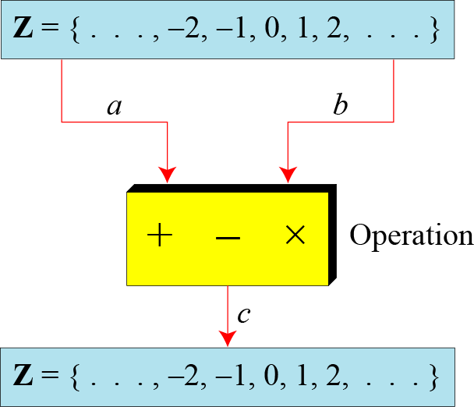
Binary Operations
In cryptography, we are interested in three binary operations applied to the set of integers. A binary operation takes two inputs and creates one output.
Figure Three binary operations for the set of integers

Slide 6
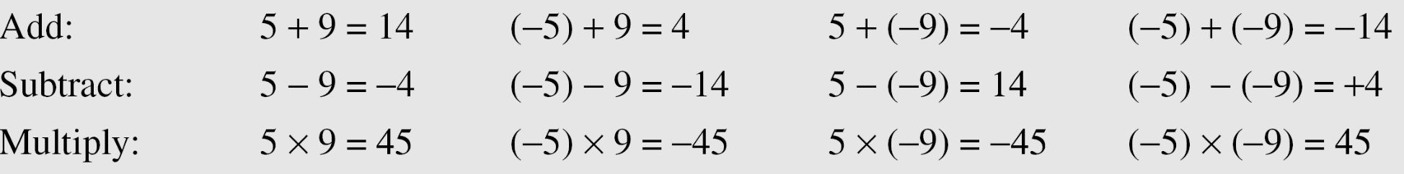
Continued
Example
The following shows the results of the three binary operations on two integers. Because each input can be either positive or negative, we can have four cases for each operation.

Slide 7
Integer Division
In integer arithmetic, if we divide a by n, we can get q
And r . The relationship between these four integers can be shown as
a = q × n + r

Slide 8
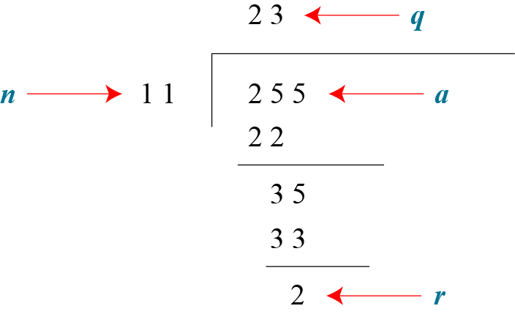
Continued
Example
Assume that a = 255 and n = 11. We can find q = 23 and R = 2 using the division algorithm.
Figure Example finding the quotient and the remainder

Slide 9
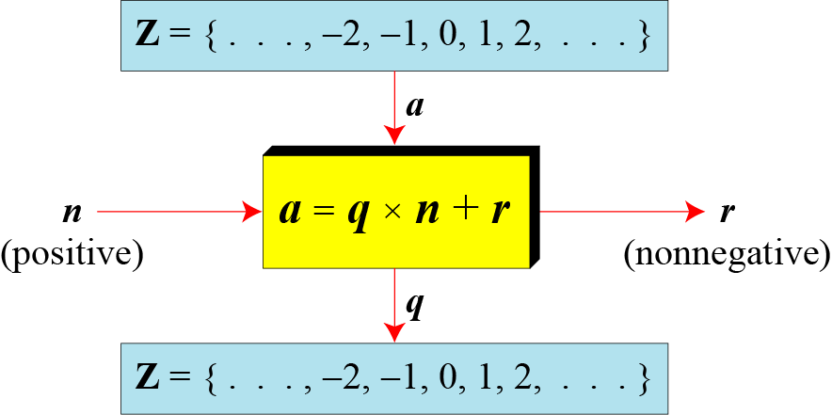
Continued
Figure Division algorithm for integers

Slide 10
Continued
Example
When we use a computer or a calculator, r and q are negative when a is negative. How can we apply the restriction that r needs to be positive? The solution is simple, we decrement the value of q by 1 and we add the value of n to r to make it positive.

Slide 11
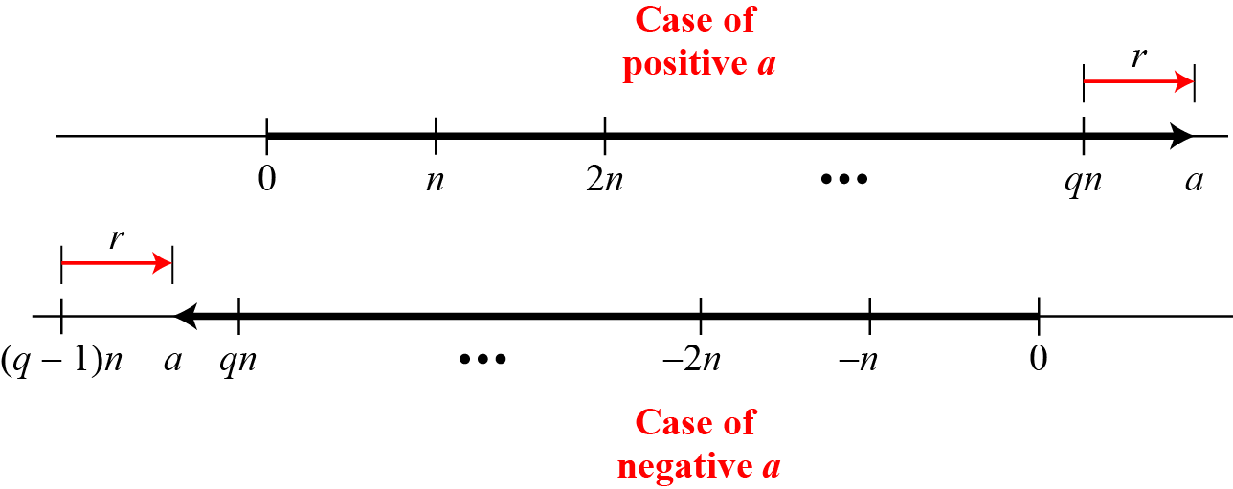
Continued
Figure Graph of division alogorithm

Slide 12
Divisbility
If a is not zero and we let r = 0 in the division relation, we get
a = q × n
If the remainder is zero,
If the remainder is not zero,

Slide 13
Continued
Example
The integer 4 divides the integer 32 because 32 = 8 × 4. We show this as
b. The number 8 does not divide the number 42 because
42 = 5 × 8 + 2. There is a remainder, the number 2, in the equation. We show this as

Slide 14
Continued
Properties
Property 1: if a|1, then a = ±1.
Property 2: if a|b and b|a, then a = ±b.
Property 3: if a|b and b|c, then a|c.
Property 4: if a|b and a|c, then a|(m × b + n × c), where m and n are arbitrary integers

Slide 15
Continued
Example

Slide 16
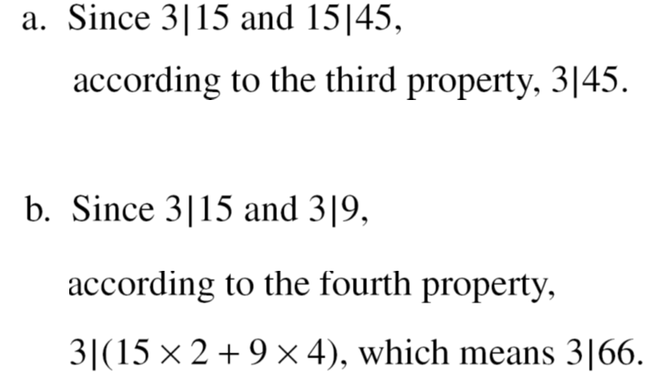
Continued
Example

Slide 17
Continued
Fact 1: The integer 1 has only one divisor, itself.
Fact 2: Any positive integer has at least
two divisors, 1 and itself (but it can have more).

Slide 18
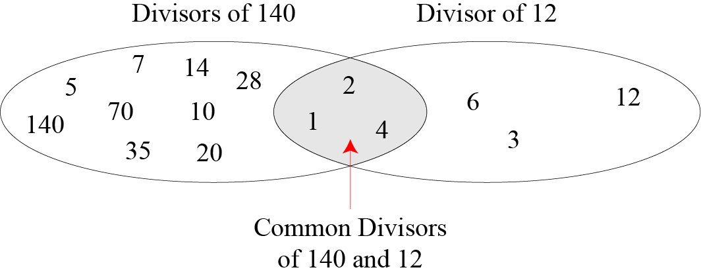
Continued
Figure Common divisors of two integers

Slide 19
Continued
Greatest Common Divisor
The greatest common divisor of two positive integers is the largest integer that can divide both integers.
Euclidean Algorithm ex. gcd (35,5)=gcd(5,0)
Fact 1: gcd (a, 0) = a Fact 2: gcd (a, b) = gcd (b, r), where r is the remainder of dividing a by b

Slide 20
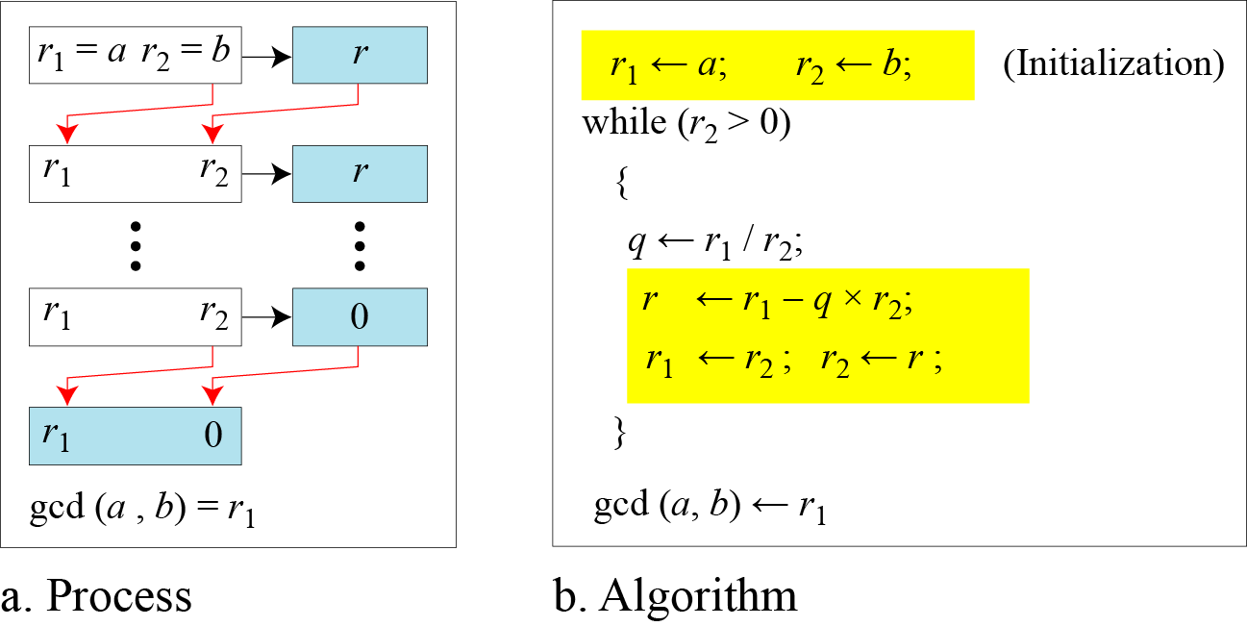
Continued
Figure Euclidean Algorithm
When gcd (a, b) = 1, we say that a and b are relatively prime.

Slide 21
Continued
When gcd (a, b) = 1, we say that a and b are relatively prime.

Slide 22
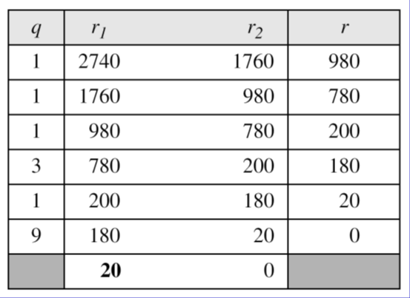
Continued
Example
Find the greatest common divisor of 2740 and 1760.
Solution
We have gcd (2740, 1760) = 20.

Slide 23
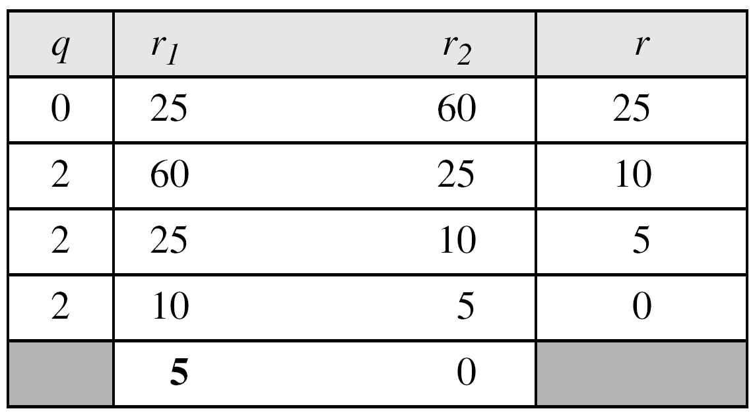
Continued
Example
Find the greatest common divisor of 25 and 60.
Solution
We have gcd (25, 65) = 5.

Slide 24

Continued
Extended Euclidean Algorithm
Given two integers a and b, we often need to find other two integers, s and t, such that
The extended Euclidean algorithm can calculate the gcd (a, b) and at the same time calculate the value of s and t.

Slide 25
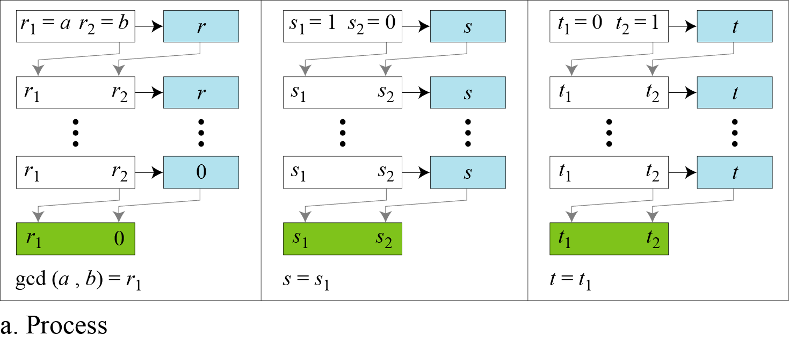
Continued
Figure Extended Euclidean algorithm, part a

Slide 26
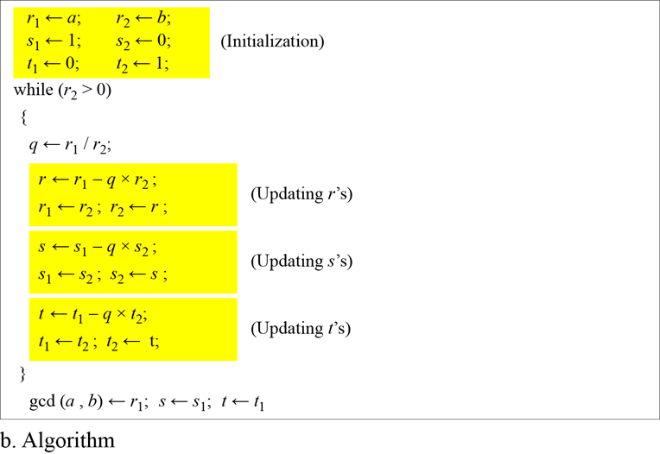
Continued
Figure Extended Euclidean algorithm, part b

Slide 27
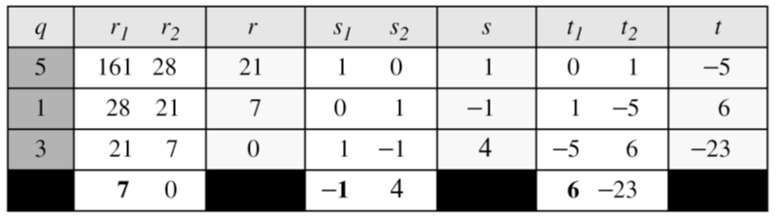
Continued
Example
Given a = 161 and b = 28, find gcd (a, b) and the values of s and t.
Solution
We get gcd (161, 28) = 7, s = −1 and t = 6.

Slide 28
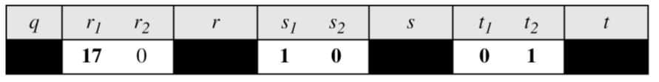
Continued
Example
Given a = 17 and b = 0, find gcd (a, b) and the values of s and t.
Solution
We get gcd (17, 0) = 17, s = 1, and t = 0.

Slide 29
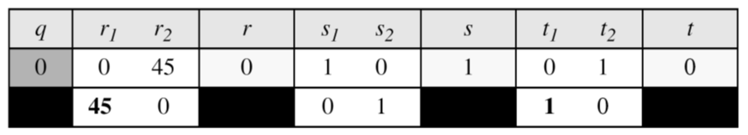
Continued
Example
Given a = 0 and b = 45, find gcd (a, b) and the values of s and t.
Solution
We get gcd (0, 45) = 45, s = 0, and t = 1.

Slide 30
MODULAR ARITHMETIC
The division relationship (a = q × n + r) discussed earlier has two inputs (a and n) and two outputs (q and r). In modular arithmetic, we are interested in only one of the outputs, the remainder r.
Topics:
1 Modular Operator 2 Set of Residues 3 Congruence 4 Operations in Z_{n}
5 Addition and Multiplication Tables
6 Different Sets

Slide 31
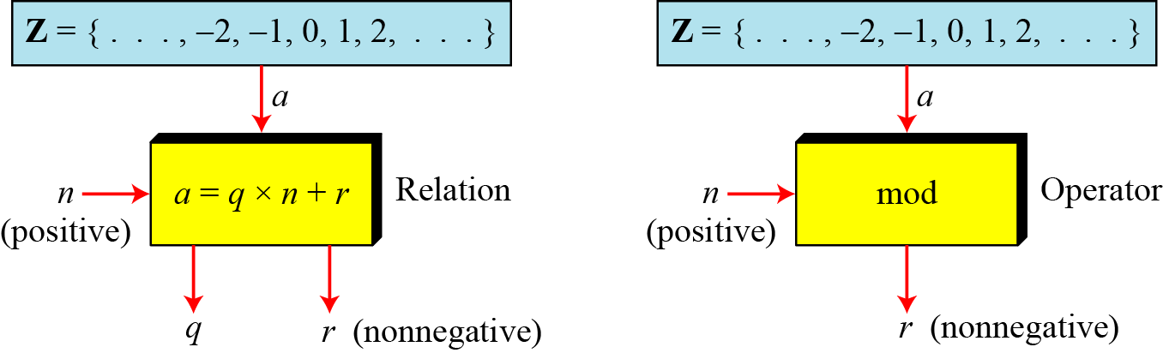
Modulo Operator
The modulo operator is shown as mod. The second input (n) is called the modulus. The output r is called the residue.
Figure Division algorithm and modulo operator

Slide 32
Continued
Example
Find the result of the following operations:
a. 27 mod 5 b. 36 mod 12
c. −18 mod 14 d. −7 mod 10
Solution
Dividing 27 by 5 results in r = 2
Dividing 36 by 12 results in r = 0.
c. Dividing −18 by 14 results in r = −4. After adding the modulus r = 10
d. Dividing −7 by 10 results in r = −7. After adding the modulus to −7, r = 3.

Slide 33
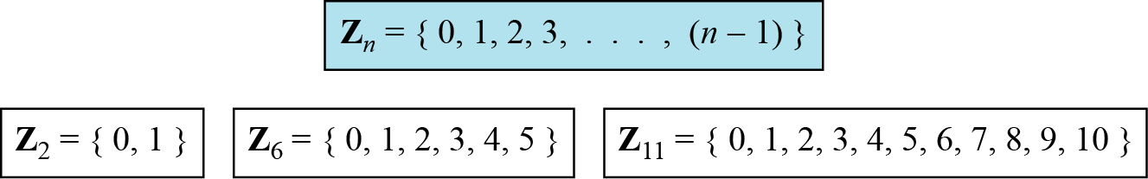
Set of Residues
The modulo operation creates a set, which in modular arithmetic is referred to as the set of least residues modulo n, or Z_{n}.
Figure Some Z_{n} sets

Slide 34
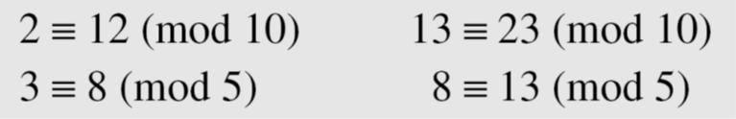
Congruence
To show that two integers are congruent, we use the congruence operator ( ≡ ). For example, we write:

Slide 35
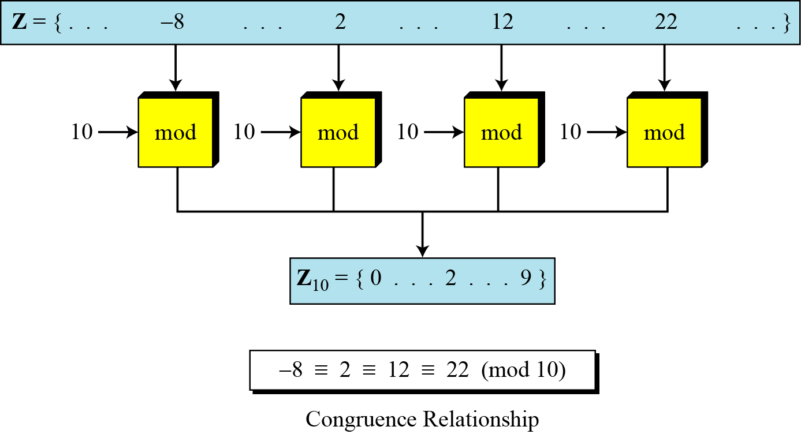
Continued
Figure Concept of congruence

Slide 36
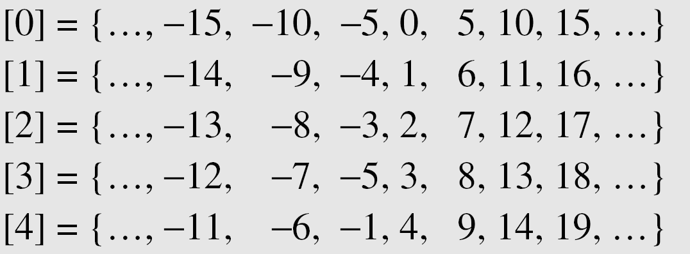
Continued
Residue Classes
A residue class [a] or [a]_{n} is the set of integers congruent modulo n.

Slide 37
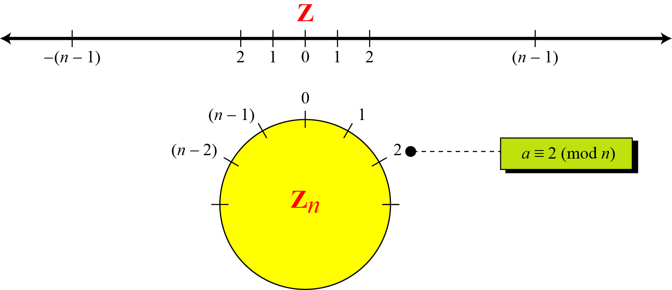
Continued
Figure Comparison of Z and Z_{n} using graphs

Slide 38
Continued
Example
We use modular arithmetic in our daily life; for example, we use a clock to measure time. Our clock system uses modulo 12 arithmetic. However, instead of a 0 we use the number 12.

Slide 39
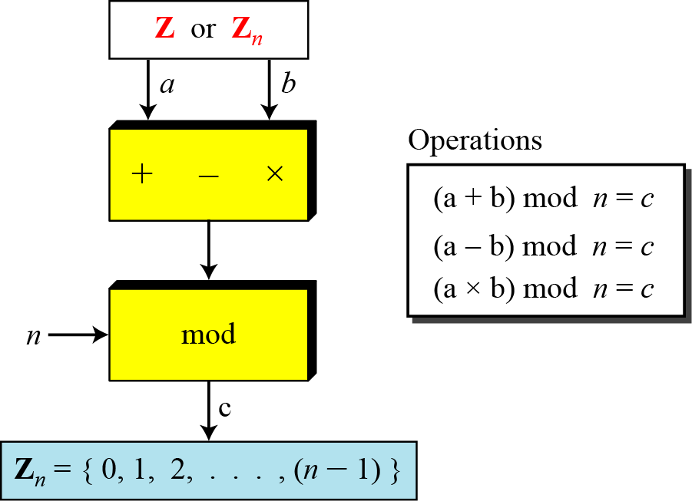
Operation in Z_{n}
The three binary operations that we discussed for the set Z can also be defined for the set Zn. The result may need to be mapped to Zn using the mod operator.
Figure Binary operations in Z_{n}

Slide 40
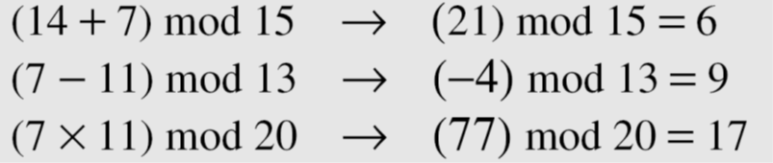
Continued
Example
Perform the following operations (the inputs come from Zn):
a. Add 7 to 14 in Z15.
b. Subtract 11 from 7 in Z13.
c. Multiply 11 by 7 in Z20.
Solution

Slide 41
Continued
Example
Perform the following operations (the inputs come from either Z or Z_{n}):
a. Add 17 to 27 in Z₁₄.
b. Subtract 43 from 12 in Z₁₃.
c. Multiply 123 by −10 in Z₁₉.
Solution

Slide 42
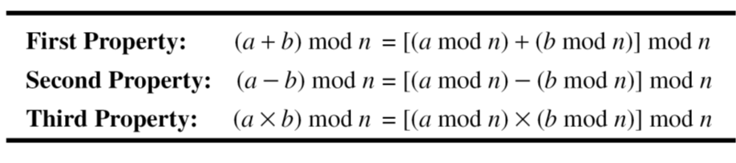
Continued
Properties

Slide 43
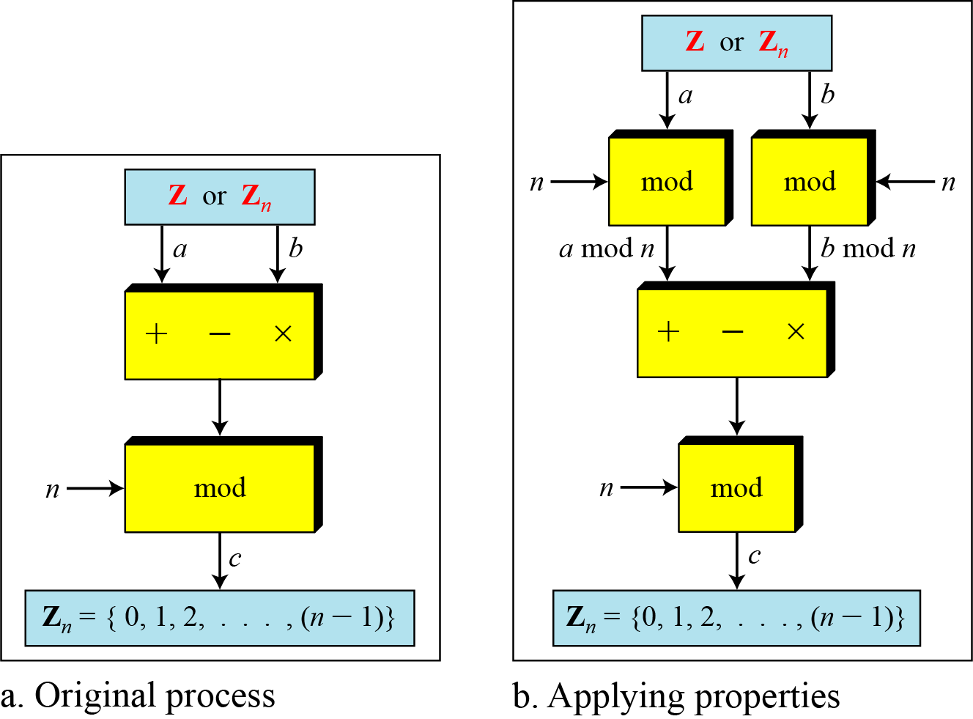
Continued
Figure Properties of mode operator

Slide 44
Continued
Example
The following shows the application of the above properties:
1. (1,723,345 + 2,124,945) mod 11 = (8 + 9) mod 11 = 6
2. (1,723,345 − 2,124,945) mod 16 = (8 − 9) mod 11 = 10
3. (1,723,345 × 2,124,945) mod 16 = (8 × 9) mod 11 = 6

Slide 45
Continued
Example
In arithmetic, we often need to find the remainder of powers of 10 when divided by an integer.

Slide 46
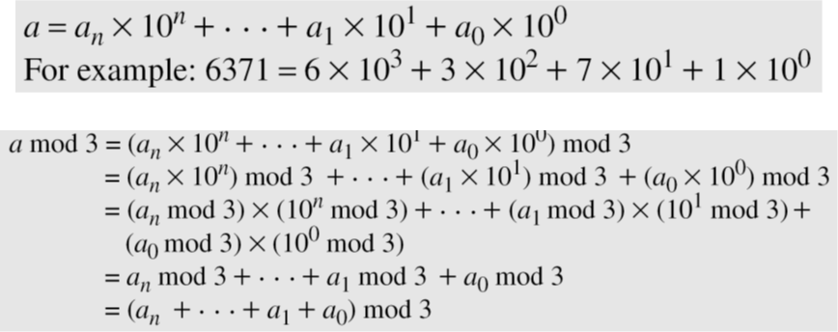
Continued
Example
We have been told in arithmetic that the remainder of an integer divided by 3 is the same as the remainder of the sum of its decimal digits. We write an integer as the sum of its digits multiplied by the powers of 10.

Slide 47
Inverses
When we are working in modular arithmetic, we often need to find the inverse of a number relative to an operation. We are normally looking for an additive inverse (relative to an addition operation) or a multiplicative inverse (relative to a multiplication operation).

Slide 48

Continue
Additive Inverse
In Z_{n}, two numbers a and b are additive inverses of each other if
In modular arithmetic, each integer has an additive inverse. The sum of an integer and its additive inverse is congruent to 0 modulo n.

Slide 49
Continued
Example
Find all additive inverse pairs in Z₁₀.
Solution
The six pairs of additive inverses are (0, 0), (1, 9), (2, 8), (3, 7), (4, 6), and (5, 5).

Slide 50

Continue
Multiplicative Inverse
In Z_{n}, two numbers a and b are the multiplicative inverse of each other if
In modular arithmetic, an integer may or may not have a multiplicative inverse.
When it does, the product of the integer and its multiplicative inverse is congruent to 1 modulo n.

Slide 51
Continued
Example
Find the multiplicative inverse of 8 in Z₁₀.
Solution
There is no multiplicative inverse because gcd (10, 8) = 2 ≠ 1. In other words, we cannot find any number between 0 and 9 such that when multiplied by 8, the result is congruent to 1.
Example
Find all multiplicative inverses in Z₁₀.
Solution
There are only three pairs: (1, 1), (3, 7) and (9, 9). The numbers 0, 2, 4, 5, 6, and 8 do not have a multiplicative inverse.

Slide 52
Continued
Example
Find all multiplicative inverse pairs in Z₁₁.
Solution
We have seven pairs: (1, 1), (2, 6), (3, 4), (5, 9), (7, 8), (9, 9), and (10, 10).

Slide 53
Continued
The extended Euclidean algorithm finds the multiplicative inverses of b in Z_{n} when n and b are given and
gcd (n, b) = 1.
The multiplicative inverse of b is the value of t after being mapped to Z_{n}.

Slide 54
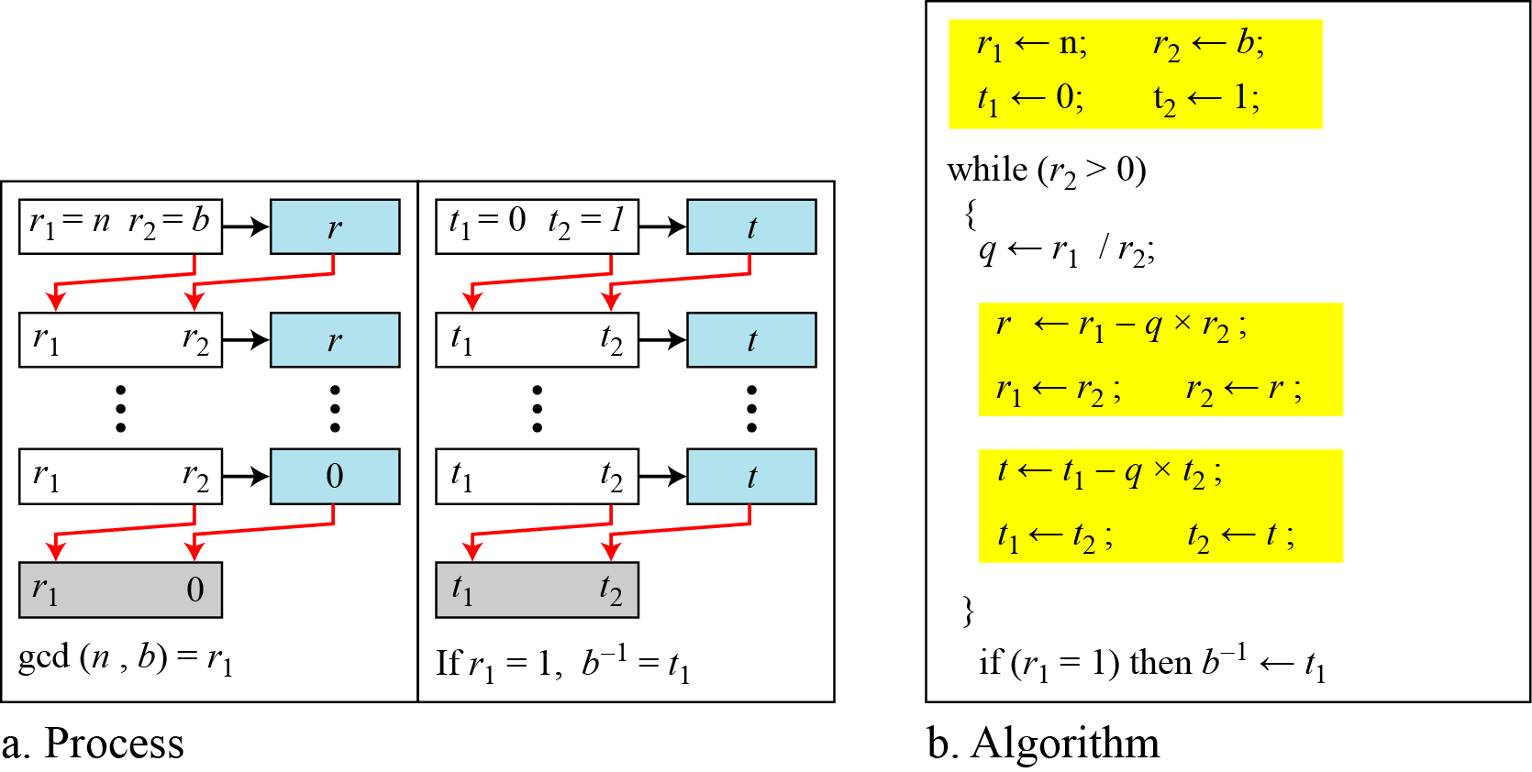
Continued
Figure Using extended Euclidean algorithm to find multiplicative inverse

Slide 55
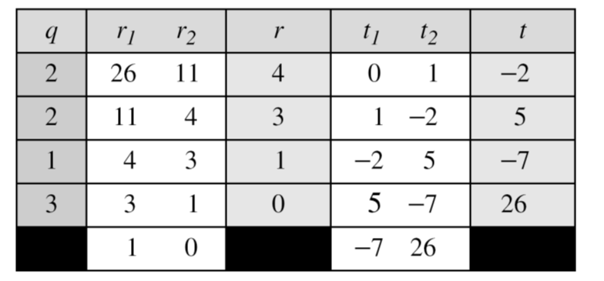
2.2.5 Continued
Example 2.25
Find the multiplicative inverse of 11 in Z₂₆.
Solution
The gcd (26, 11) is 1; the inverse of 11 is −7 or 19.

Slide 56
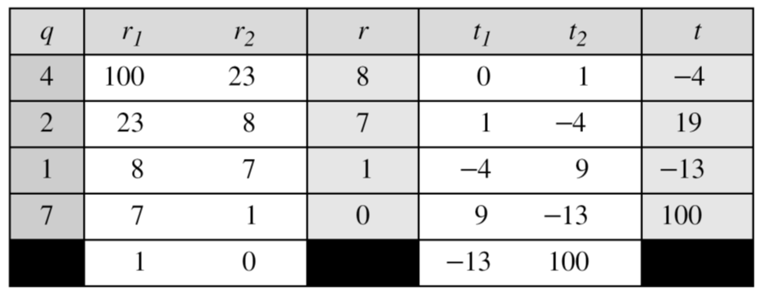
Continued
Example
Find the multiplicative inverse of 23 in Z₁₀₀.
Solution
The gcd (100, 23) is 1; the inverse of 23 is −13 or 87.

Slide 57
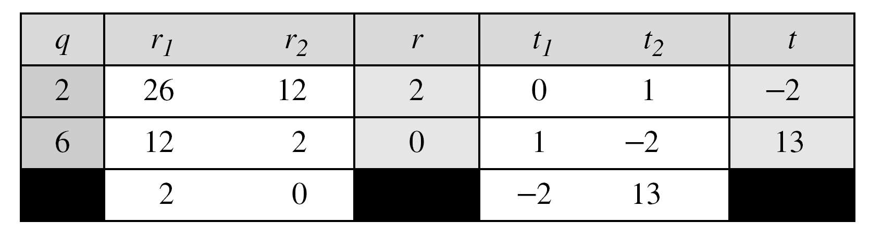
Continued
Example
Find the inverse of 12 in Z₂₆.
Solution
The gcd (26, 12) is 2; the inverse does not exist.

Slide 58
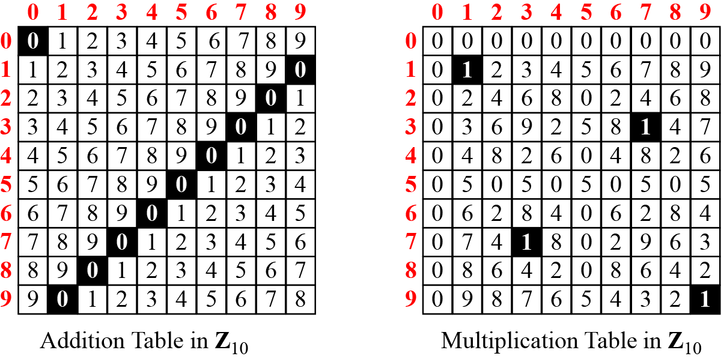
Addition and Multiplication Tables
Figure Addition and multiplication table for Z₁₀

Slide 59
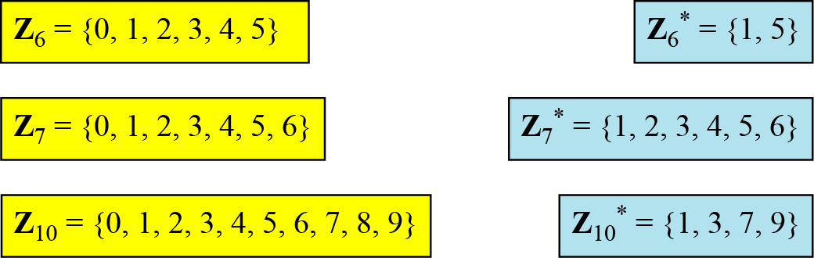
Different Sets
Figure Some Z_{n} and Z_{n}* sets
We need to use Z_{n} when additive inverses are needed; we need to use Zn* when multiplicative inverses are needed.

Slide 60
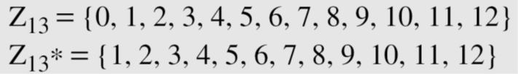
Two More Sets
Cryptography often uses two more sets: Z_{p} and Z_{p}*. The modulus in these two sets is a prime number.

Slide 61
MATRICES
In cryptography we need to handle matrices. Although this topic belongs to a special branch of algebra called linear algebra, the following brief review of matrices is necessary preparation for the study of cryptography.
Topics:
1 Definitions 2 Operations and Relations 3 Determinants
4 Residue Matrices

Slide 62
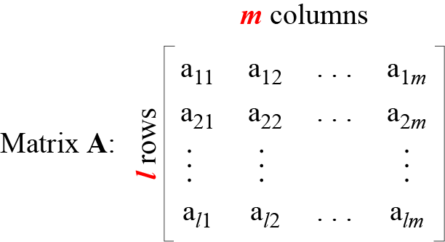
Definition
Figure A matrix of size l × m

Slide 63
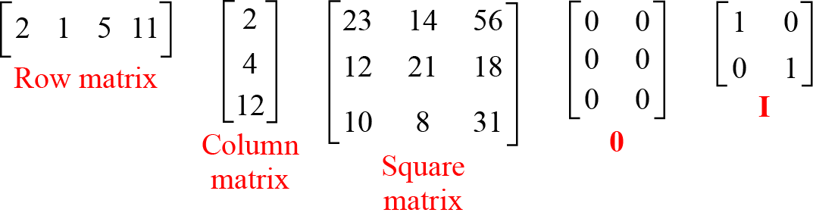
Continued
Figure Examples of matrices

Slide 64
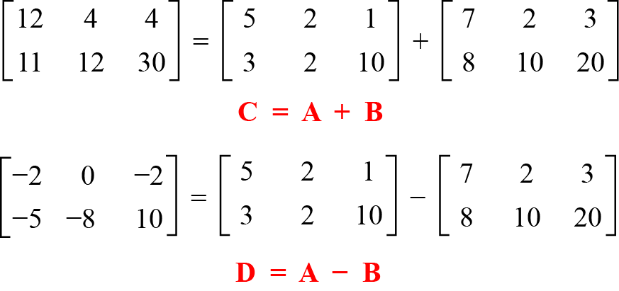
Operations and Relations
Example
Figure shows an example of addition and subtraction.
Figure Addition and subtraction of matrices

Slide 65
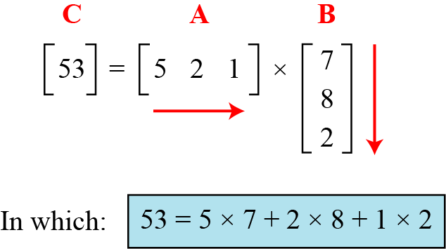
Continued
Example
Figure shows the product of a row matrix (1 × 3) by a column matrix (3 × 1). The result is a matrix of size 1 × 1.
Figure Multiplication of a row matrix by a column matrix

Slide 66
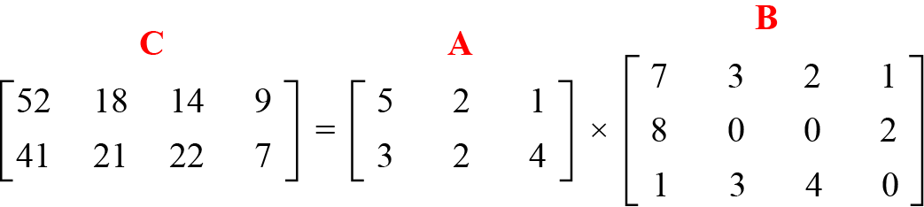
Continued
Example
Figure shows the product of a 2 × 3 matrix by a 3 × 4 matrix. The result is a 2 × 4 matrix.
Figure Multiplication of a 2 × 3 matrix by a 3 × 4 matrix

Slide 67
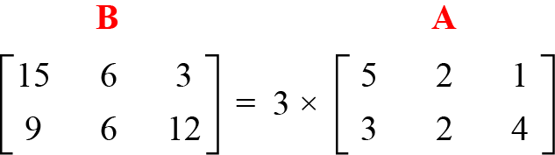
Continued
Example
Figure shows an example of scalar multiplication.
Figure Scalar multiplication

Slide 68
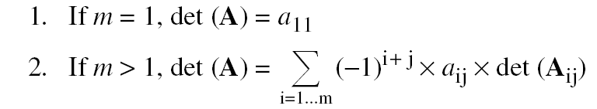
Determinant
The determinant of a square matrix A of size m × m denoted as det (A) is a scalar calculated recursively as shown below:
The determinant is defined only for a square matrix.

Slide 69
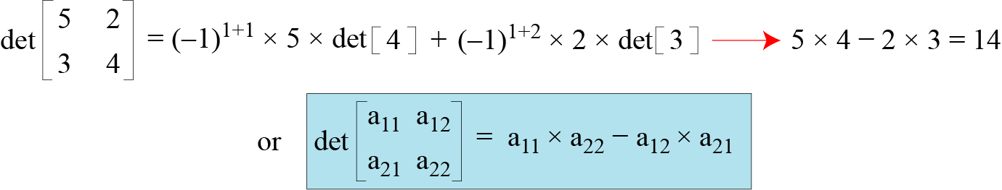
Continued
Example
Figure shows how we can calculate the determinant of a 2 × 2 matrix based on the determinant of a 1 × 1 matrix.
Figure Calculating the determinant of a 2 × 2 matrix

Slide 70
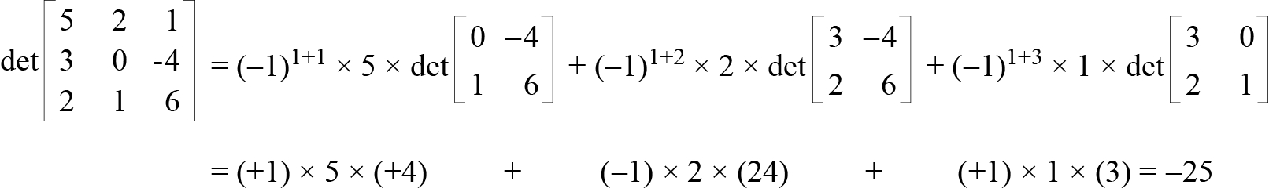
Continued
Example
Figure shows the calculation of the determinant of a 3 × 3 matrix.
Figure Calculating the determinant of a 3 × 3 matrix

Slide 71
Inverses
Multiplicative inverses are only defined for square matrices.

Slide 72
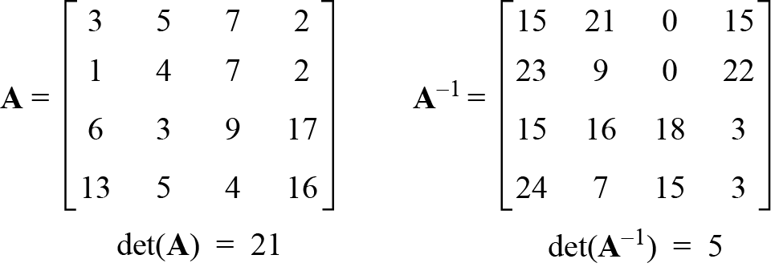
Residue Matrices
Cryptography uses residue matrices: matrices where all elements are in Z_{n}. A residue matrix has a multiplicative inverse if gcd (det(A), n) = 1.
Example
Figure A residue matrix and its multiplicative inverse in Z₂₆

Slide 73
LINEAR CONGRUENCE
Cryptography often involves solving an equation or a set of equations of one or more variables with coefficient in Z_{n}. Here, we shall discuss how to solve equations when the power of each variable is 1 (linear equation).
Topics:
1 Single-Variable Linear Equations 2 Set of Linear Equations

Slide 74


Single-Variable Linear Equations
Equations of the form ax ≡ b (mod n ) might have no solution or a limited number of solutions.

Slide 75
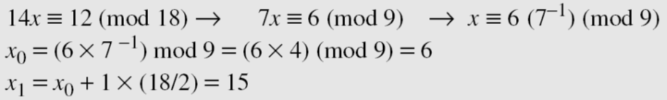
Continued
Example
Solve the equation 10 x ≡ 2(mod 15).
Solution
First we find the gcd (10 and 15) = 5. Since 5 does not divide 2, we have no solution.
Example
Solve the equation 14 x ≡ 12 (mod 18).
Solution

Slide 76
Continued
Example
Solve the equation 3x + 4 ≡ 6 (mod 13).
Solution
First we change the equation to the form ax ≡ b (mod n). We add −4 (the additive inverse of 4) to both sides, which give 3x ≡ 2 (mod 13). Because gcd (3, 13) = 1, the equation has only one solution, which is x₀ = (2 × 3⁻¹) mod 13 = 18 mod 13 = 5. We can see that the answer satisfies the original equation: 3 × 5 + 4 ≡ 6 (mod 13).

Slide 77
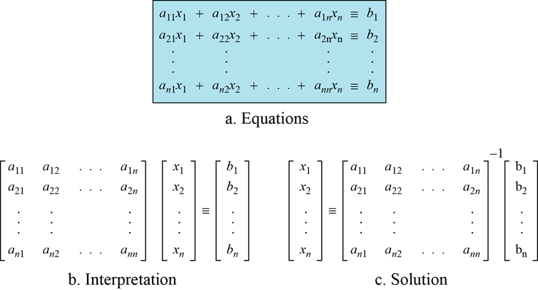
Single-Variable Linear Equations
We can also solve a set of linear equations with the same modulus if the matrix formed from the coefficients of the variables is invertible.
Figure Set of linear equations

Slide 78
Continued
Example
Solve the set of following three equations:
Solution
The result is x ≡ 15 (mod 16), y ≡ 4 (mod 16), and z ≡ 14 (mod 16). We can check the answer by inserting these values into the equations.

Slide 79
Annex
Linear Diophantine Equation

Slide 80
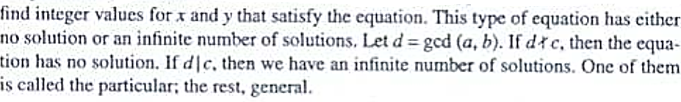
Linear Diophantine Equation
A linear Diophantine equation of two variables is ax + by = c.

Slide 81
Linear Diophantine Equation
d=gcd(a,b)
Particular solution: x₀ = (c/d)s and y₀ = (c/d)t
General solutions:
x = x₀ + k (b/d) and y = y₀ − k(a/d) where k is an integer

Slide 82

Continued
Example
Find the particular and general solutions to the equation
21x + 14y = 35.
Solution

Slide 83
Continued
Example
For example, imagine we want to cash a $100 check and get
some $20 and some $5 bills. We have many choices, which we can find by solving the corresponding Diophantine equation 20x + 5y = 100. Since d = gcd (20, 5) = 5 and 5 | 100, the equation has an infinite number of solutions, but only a few of them are acceptable in this case The general solutions
with x and y nonnegative are
(0, 20), (1, 16), (2, 12), (3, 8), (4, 4), (5, 0).

